Slide 1


Students names: | Aaesha R. Mazrooei | Aaesha S. Zaabi
Students ID: | 200401654 | 200402115
Group #: | 21
Faculty Supervisor: | Dr. Salah Bouktif

Slide 2

Outline
RCCI Overview
  Structure
RCCI Operation Centre System
    RCCI Operating Center Overview
    Meeting Project Overview
    Project Configuration
    Design
    Testing
    Software Demo
Formatting and Preparation for RCCI’s PCs
Lessons Learned
Individual Presentation

Slide 3
RCCI Overview
Location
Established on 22/12/1976
Financially and administratively independent
Second oldest Chamber in UAE
Considered as a services provider
Many publications
  Al Ghorfa Magazine,
  Economics Vision
  Nabdh Al Ghorfa online newsletter

Slide 4
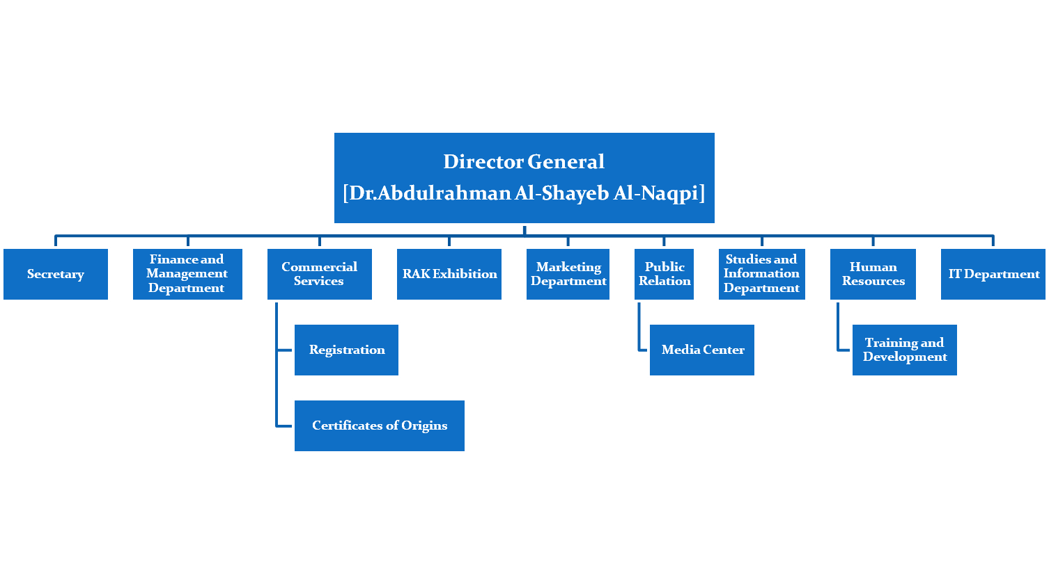
Organization Structure _{69 Employees}

Slide 5

Meetings Project

Slide 6

IntelliJ IDEA Software
MySQL
Mysql connector for JAVA
Apache Tomcat

Slide 7
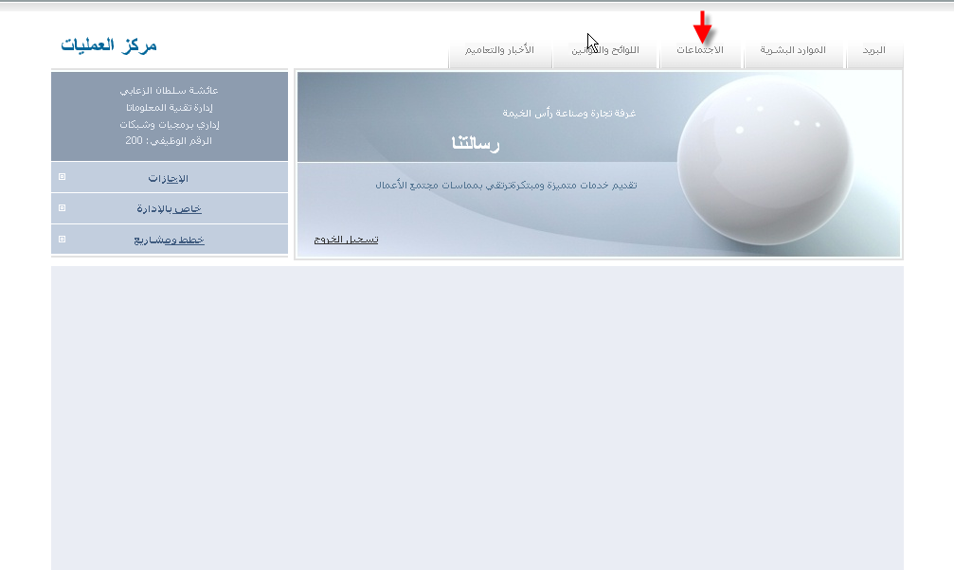
RCCI Operating Center Overview

Slide 8
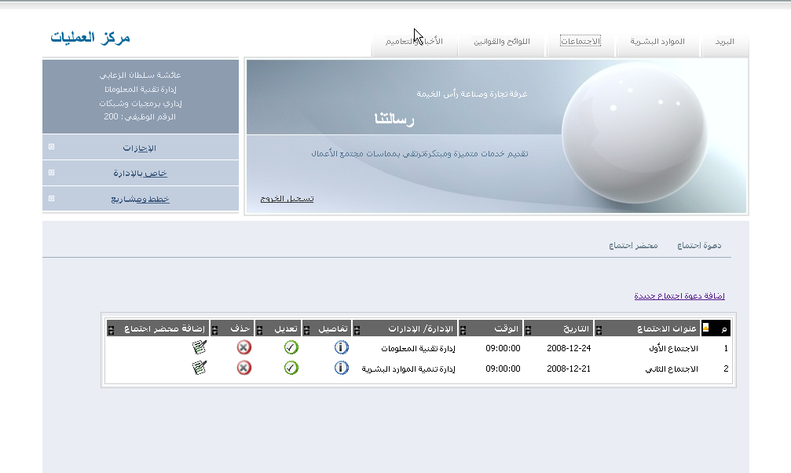
Meeting Project Overview

Slide 9


Slide 10
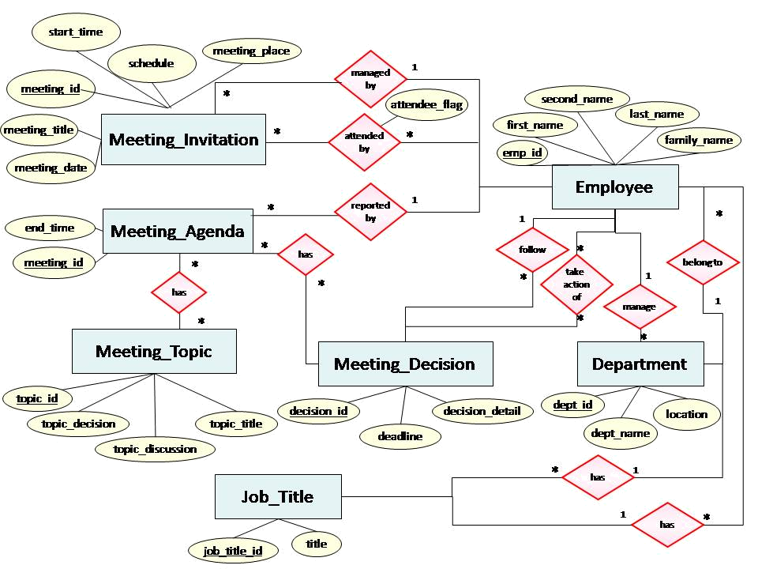
Database Design ERD

Slide 11
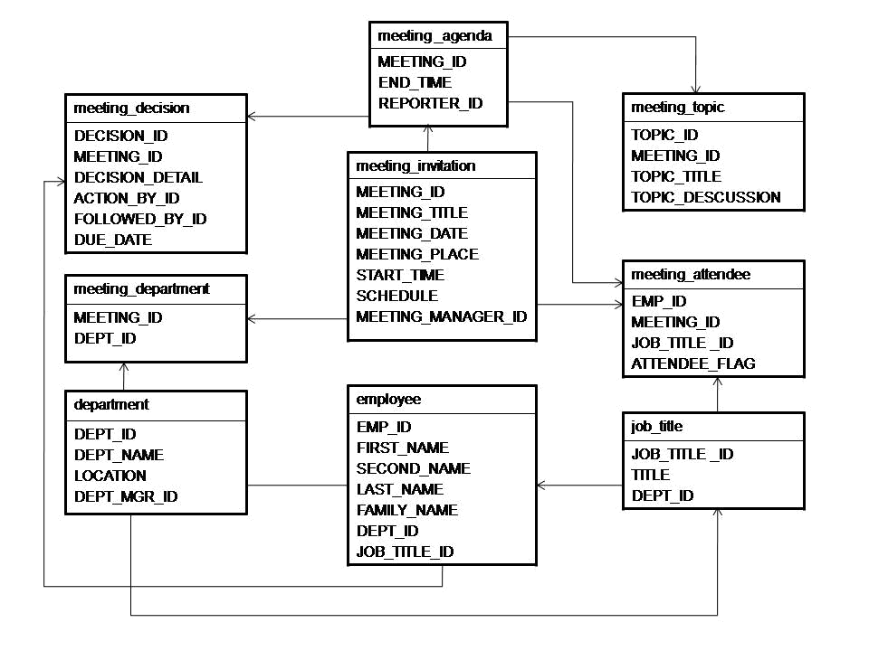
Database Design DB Structure

Slide 12
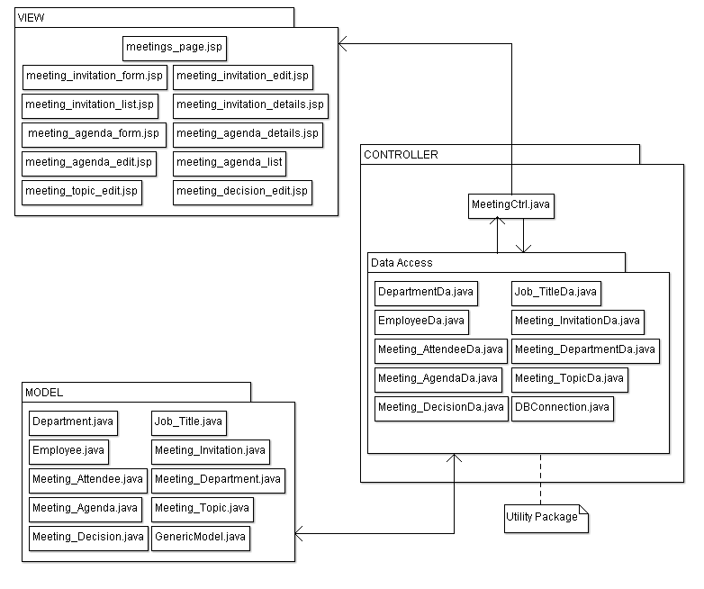
MVC Architecture

Slide 13

Generate test cases.
Example of adding a new meeting invitation.

Slide 14

Test Case ID | TC4: Add a Meeting Invitation
Description | An employee can add a meeting invitation.
Pre-requisite | An employee must be at Meeting Invitation form page.
Input | Meeting title=Installing new software Meeting place=meeting room Meeting date=23/12/2008 Meeting time=10:00:00 Meeting attendee=any 3 from IT department (Ctrl press) Meeting department=IT department Meeting manager= Fatima Ali Mazrooei Click on submit
Expected Output | A meeting list page is opened and updated with the new record containing the added information.
Actual Output | A meeting invitation with title installing new software is added successfully in the list.
Result | Pass

Slide 15
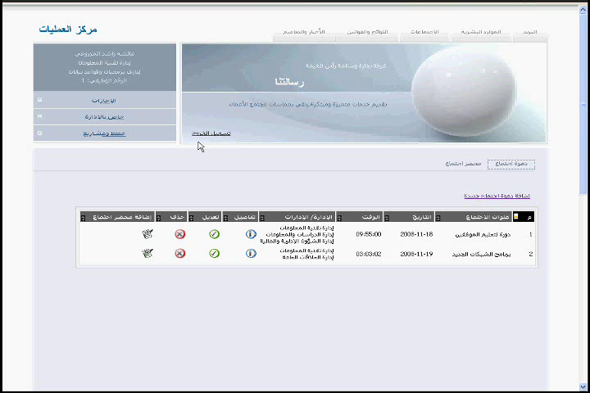

Slide 16

Format
Prepare
SpiceWork Web-based Software

Slide 17
Learned Lessons
Work Environment
Communication Skills
Expand Knowledge

Slide 18

Overview of the section I've worked in
  12 Departments
Responsibilities and Achievements
Acknowledgment

Slide 19
Responsibilities & Achievements
IT Department
Formatting and preparing 28 PCs
  Spiceworks
  Written steps
Proposal report for Hot Spot Express Software.
Proposal report for Shutdown Software.
Requirement document for Finance Department.
Aaesha Mazrooei

Slide 20
Responsibilities & Achievements
IT Department
Manage e-mail accounts
  EIM’s Delegated Administrator System
  MS Outlook Contact List
Help Desk
Work with other software:
  Websense Software
  Time and Attendance Control System
Meeting Invitation
  Follow my Project Progression
Aaesha Mazrooei

Slide 21

MANY THANKS
RCCI supervisor :
Kalthoom Ibrahim
IT developers :
Fatima Mazrooei
Mahmood Marzooqi
Faculty Supervisor:
Dr. Salah Buktif
Judgments
Friend:
Aaesha Zaabi
Aaesha Mazrooei

Slide 22

Overview IT Department
Responsibilities and Achievements

Slide 23
Responsibilities & Achievements
IT Department
Writing Software Proposals
  ANT Labs SSG III Time Based Billing software
  Slowdog smart shutdown
Employees’ Time Attendance and Access Control System
Working on Spiceworks (Helpdesk system)
Aaesha Zaabi

Slide 24
Responsibilities & Achievements
IT Department
Organizing RCCI Employees E-mails
Formatting Employee’s PCs
Working on Meetings Project
  Meeting Agenda
Preparing a Requirements Document (Finance Department )
Aaesha Zaabi

